Slide 1
Evaluating the Robustness of Segmentation Models Against Adversarial Patches in Off-Road Environments
Christopher Salas, Mert D. Pesé, Bing Li, Jonathon Smereka, Long Cheng
DISTRIBUTION STATEMENT A.
Approved for public release; distribution is unlimited. OPSEC #: 10920

Slide 2
Research Goals and Questions
Core Research Question: How robust are proposed semantic segmentation models for off-road environments to localized adversarial perturbations?
Motivation: This work aims to bridge the current research gap in understanding how known segmentation model vulnerabilities can impact autonomous vehicles in an offroad setting.
Goal: Identify which segmentation models deliver accurate predictions for off-road terrain while exhibiting robustness to adversarial patches.

Slide 3

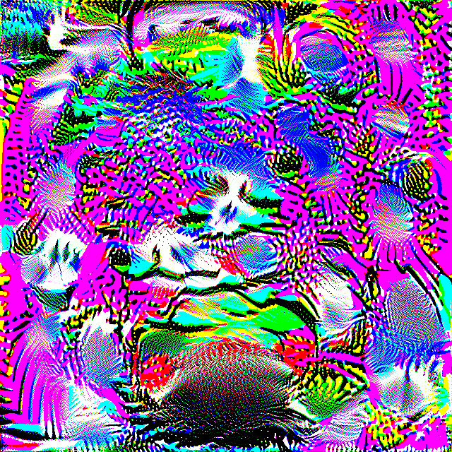




Methodology
Train segmentation models on Modified YCOR Off-road Dataset
Optimize adversarial patches for each model
Evaluate the impact on performance
Segmentation Models Evaluated:
ResNet34+Unet
EfficientViT
YOLOv11n/s-seg
YOLOv12n/s-seg
LaVAN Patch
DiAP Patch
Patch-Wise
    Adversarial Patches Used:
    LaVAN Patch
    SemSegAdvPatch
    Patch-Wise
    DiAP
    AdvTransferpatch
    Dummy Patch
SemSegAdv Patch
AdvTransfer Patch
Dummy Patch

Slide 4
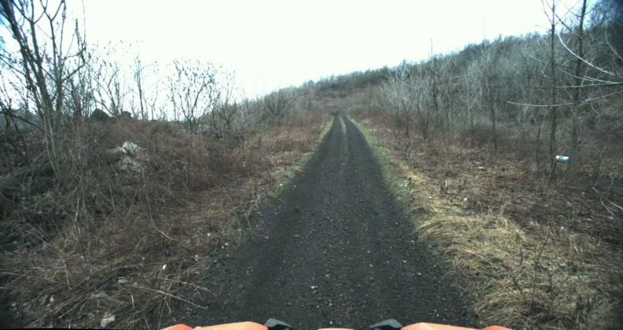
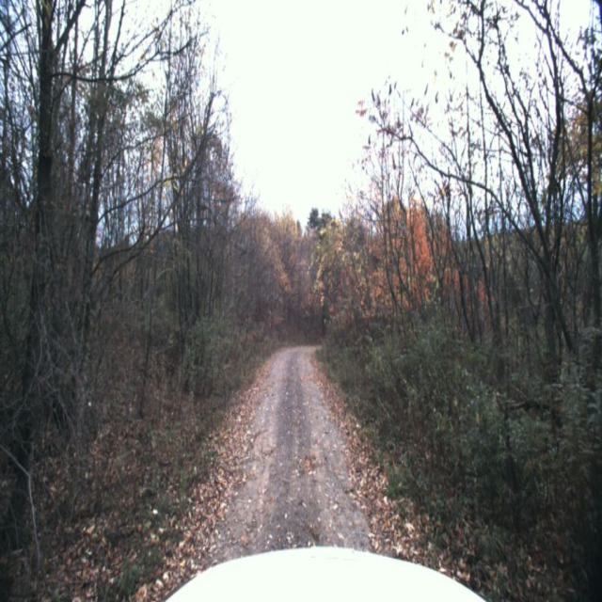
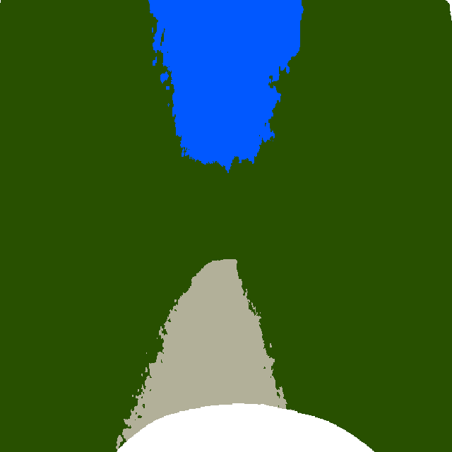
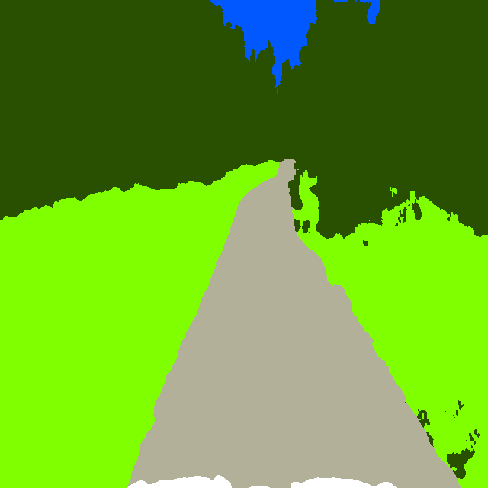
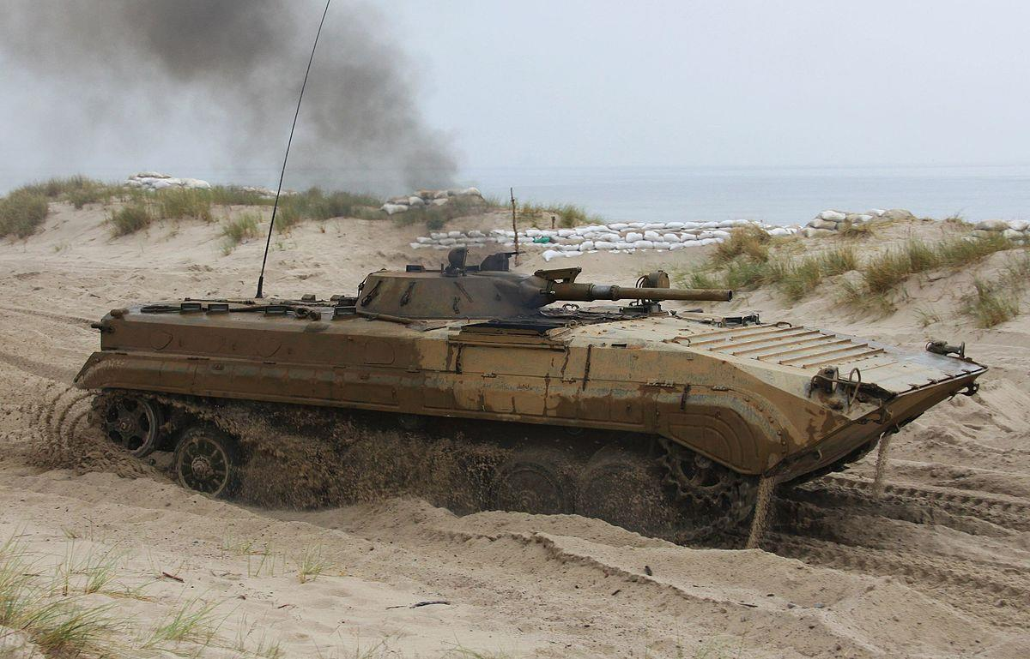
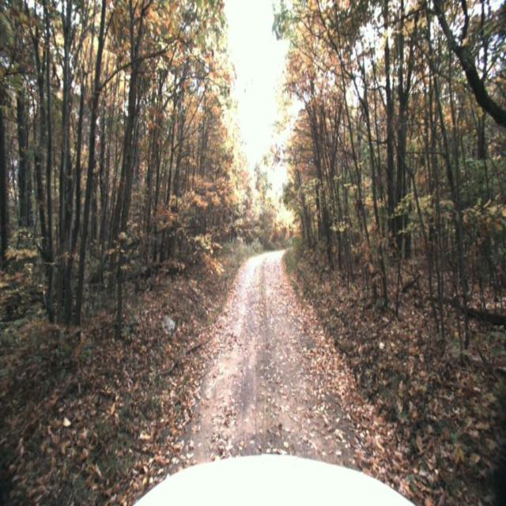
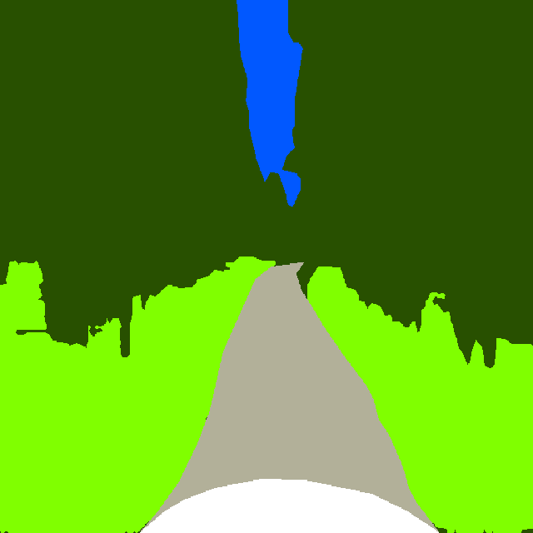
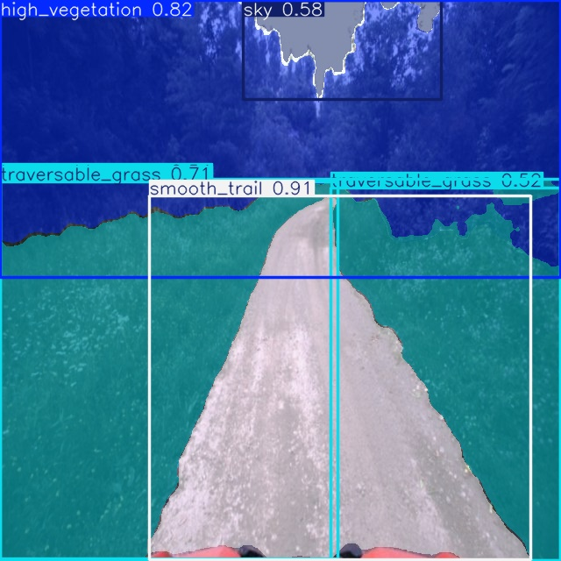
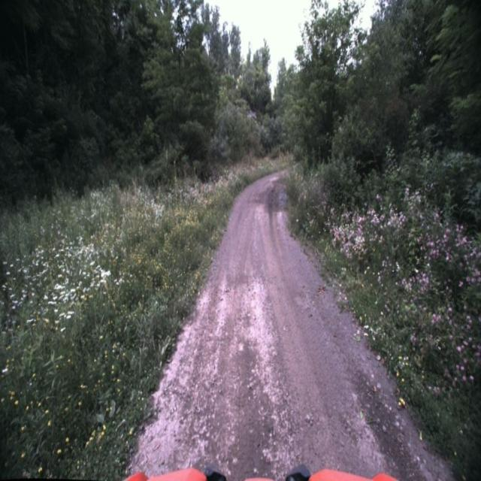
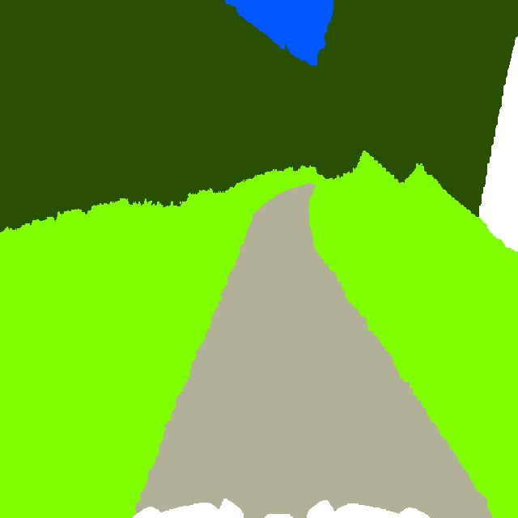
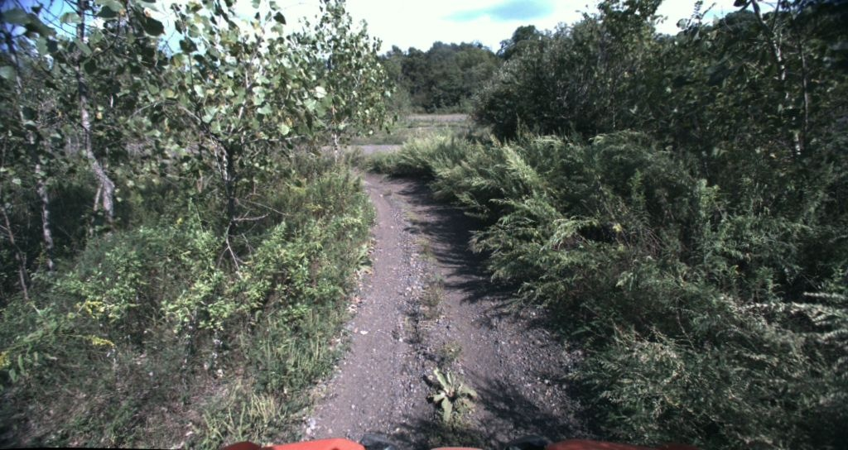
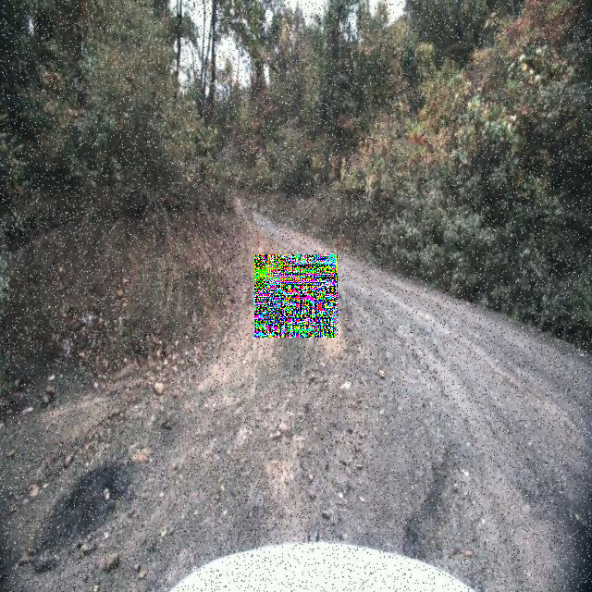
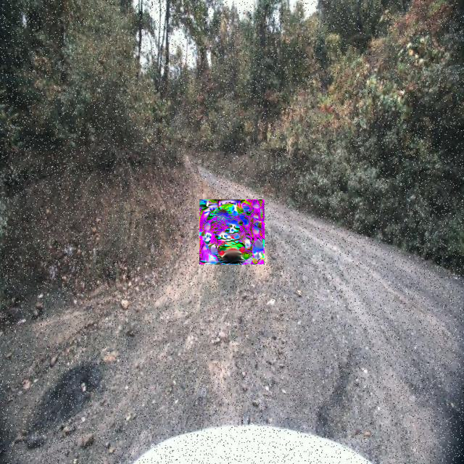
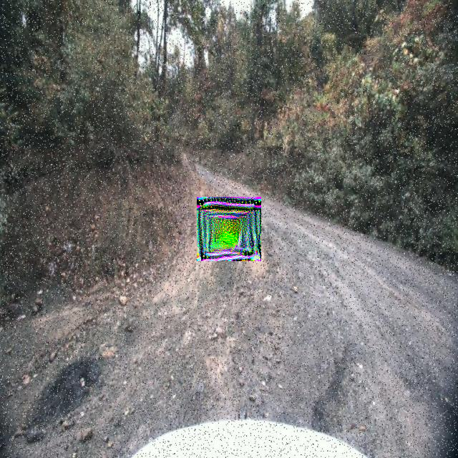
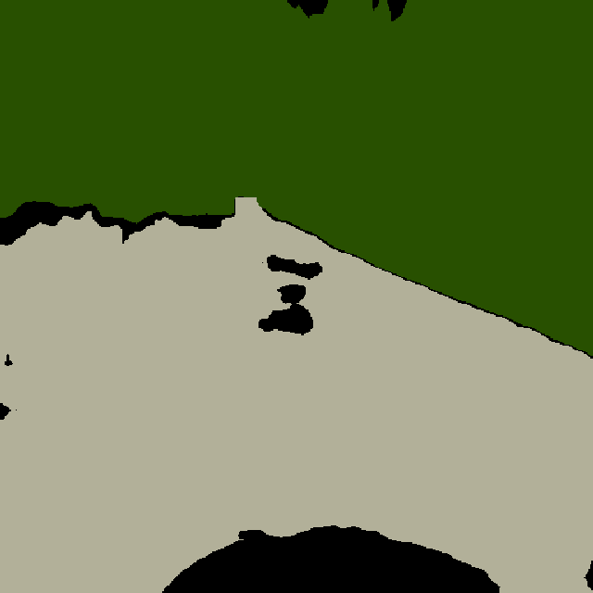
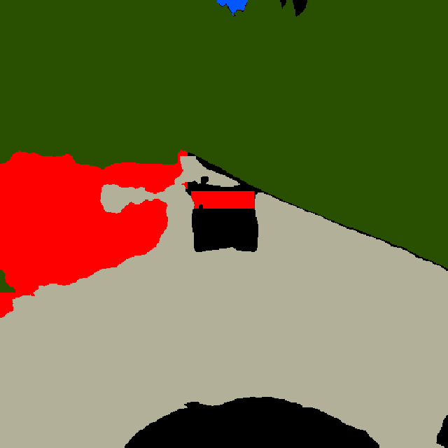
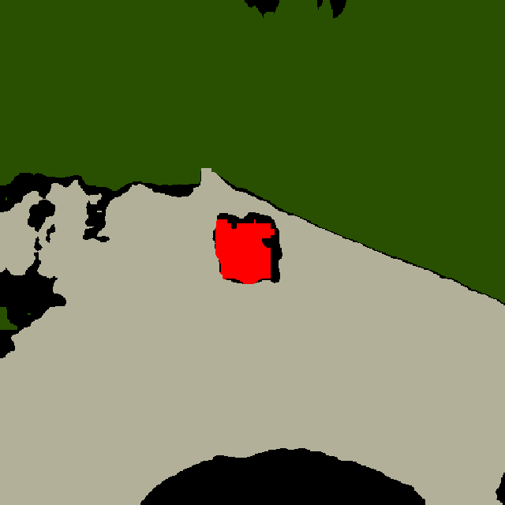

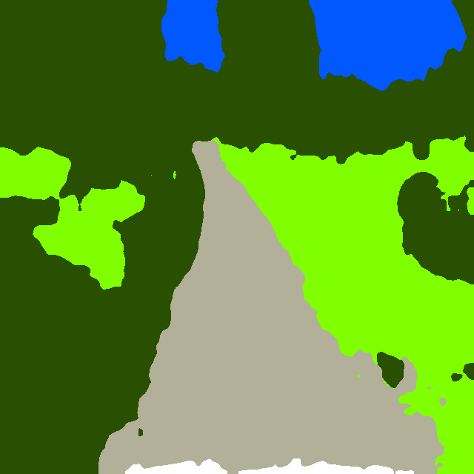
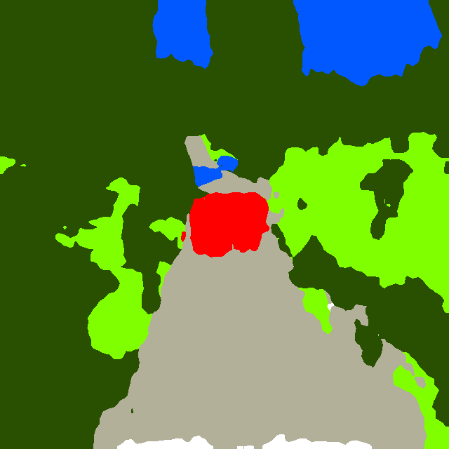

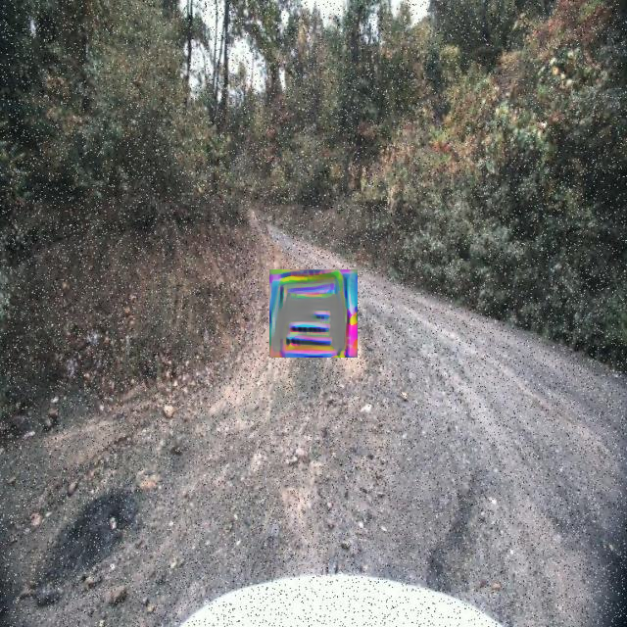
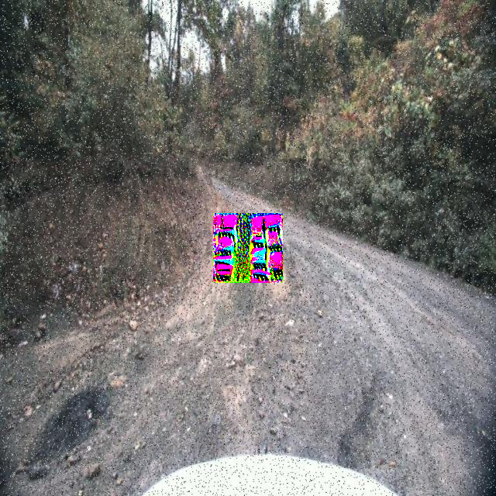
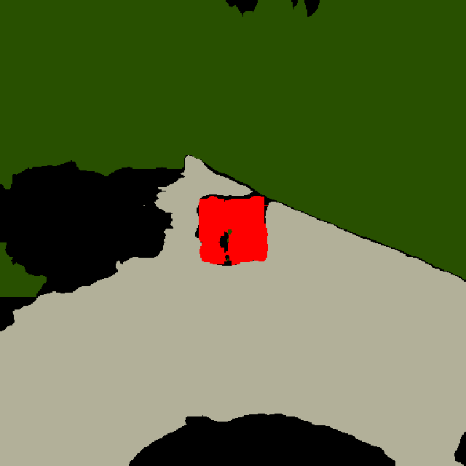
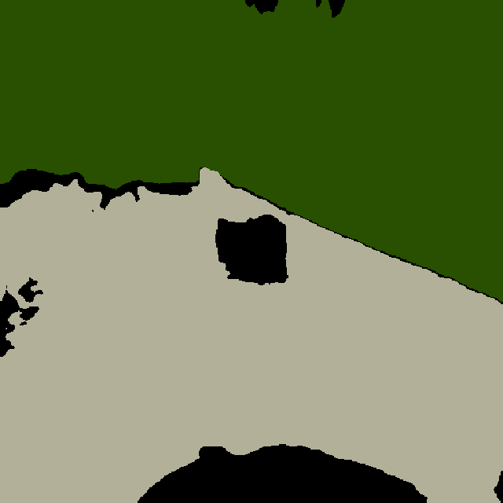
Methodology Overview
Train Segmentation Models
Optimize Adversarial Patches on Trained Weights
Segmentation Model Architecture
Modified YCOR Train Split
Patch Optimization Loss Function
Patch Generated
Modified YCOR Dataset
CNN-Based
Clean Predictions
ResNet34+UNet
LaVAN: F( )
Trained Weights
Transformer-Based
ResNet34+Unet
EfficientViT
YOLOv11n-seg
YOLOv11s-seg
YOLOv12n-seg
YOLOv12s-seg
SemSegAdv: F( )
EfficientViT
Patch-Wise: F( )
Single-Shot CNN
DiAP: F( )
YOLOv11n-seg
YOLOv11s-seg
YOLOv12n-seg
YOLOv12s-seg
Images
Labels
AdvTransfer: F( )
Compare Patch Effect on Traversable Class Prediction
Evaluate Model Performance With Patches Present
Traversable Classes
Trained Weights
Clean Predictions
Patched Predictions
Trained Weights
Patched Modified YCOR Val Split
Patched Predictions
ResNet34+Unet
EfficientViT
YOLOv11n-seg
YOLOv11s-seg
YOLOv12n-seg
YOLOv12s-seg
Traversable Grass
ResNet34+Unet
EfficientViT
YOLOv11n-seg
YOLOv11s-seg
YOLOv12n-seg
YOLOv12s-seg
vs.
Smooth Trail

Slide 5
Step 1: Train Segmentation Models
Train 6 different segmentation models
Use the modified YCOR dataset
The 6 models represent a variety of architectures:
CNN-Based
Transformer-Based
Single Shot CNN-Based
Train Segmentation Models
Segmentation Model Architecture
Modified YCOR Dataset
CNN-Based
Clean Predictions
ResNet34+UNet
Transformer-Based
EfficientViT
Single-Shot CNN
YOLOv11n-seg
YOLOv11s-seg
YOLOv12n-seg
YOLOv12s-seg
Images
Labels

Slide 6
Step 2: Optimize Adversarial Patches on Trained Weights
Optimize 5 diverse adversarial patches
Use the trained victim model weights
Optimize patches separately for each model
Total: 30 unique patches
Optimize Adversarial Patches on Trained Weights
Modified YCOR Train Split
Patch Optimization Loss Function
Patch Generated
LaVAN: F( )
Trained Weights
ResNet34+Unet
EfficientViT
YOLOv11n-seg
YOLOv11s-seg
YOLOv12n-seg
YOLOv12s-seg
SemSegAdv: F( )
Patch-Wise: F( )
DiAP: F( )
AdvTransfer: F( )

Slide 7
Step 3: Evaluate Overall Model Performance with Patches Present
Evaluate each model on the full validation set.
Patches placed at the image center.
Center placement overlaps traversable terrain in 66.51% of validation images.
Evaluate Model Performance With Patches Present
Trained Weights
Patched Modified YCOR Val Split
Patched Predictions
ResNet34+Unet
EfficientViT
YOLOv11n-seg
YOLOv11s-seg
YOLOv12n-seg
YOLOv12s-seg

Slide 8
Step 4: Compare Patch Effect on
Traversable Class Prediction
Analyze how patches affect terrain classification
Focus on traversable vs non-traversable terrain:
Off-road scenes lack clear driving cues
Hence, safe navigation depends on telling drivable terrain apart from undrivable.
Compare Patch Effect on Traversable Class Prediction
Traversable Classes
Trained Weights
Clean Predictions
Patched Predictions
Traversable Grass
ResNet34+Unet
EfficientViT
YOLOv11n-seg
YOLOv11s-seg
YOLOv12n-seg
YOLOv12s-seg
Vs.
Smooth Trail

Slide 9
Key Findings and Results
We measure segmentation accuracy outside the patch region.
EfficientViT was the most robust model under patch attacks.
YOLOv11 and YOLOv12 had comparable clean accuracy,
but showed the largest drops under attack.
Dataset | Patch Attack | ResNet34+Unet | EfficientViT | YOLOv11n-seg | YOLOv11s-seg | YOLOv12n-seg | YOLOv12s-seg
Modified YCOR Val Split | Clean | 87.69% | 96.85% | 92.88% | 90.99% | 95.97% | 94.35%
 | Dummy Patch | 87.01% | 96.23% | 92.27% | 90.40% | 95.03% | 93.72%
 | LaVAN | 85.59% | 95.81% | 66.33% | 82.87% | 87.13% | 85.79%
 | SemSegAdv | 85.86% | 96.11% | 88.33% | 73.24% | 91.78% | 75.37%
 | Patch-Wise | 86.94% | 93.32% | 90.61% | 89.90% | 92.87% | 92.32%
 | DiAP | 85.47% | 95.05% | 89.52% | 87.78% | 93.81% | 92.62%
 | AdvTransfer | 79.04% | 96.31% | 91.20% | 89.42% | 93.87% | 92.23%

Slide 10
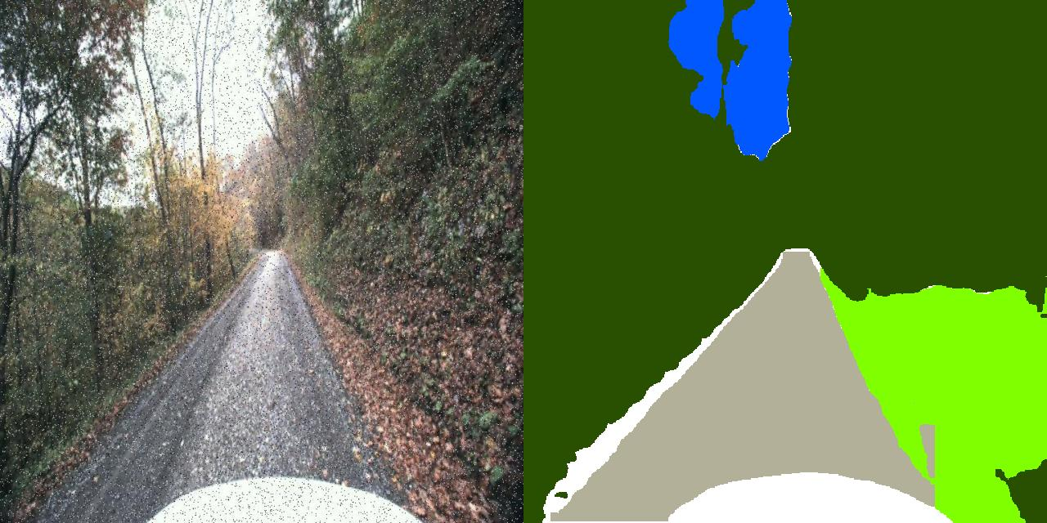
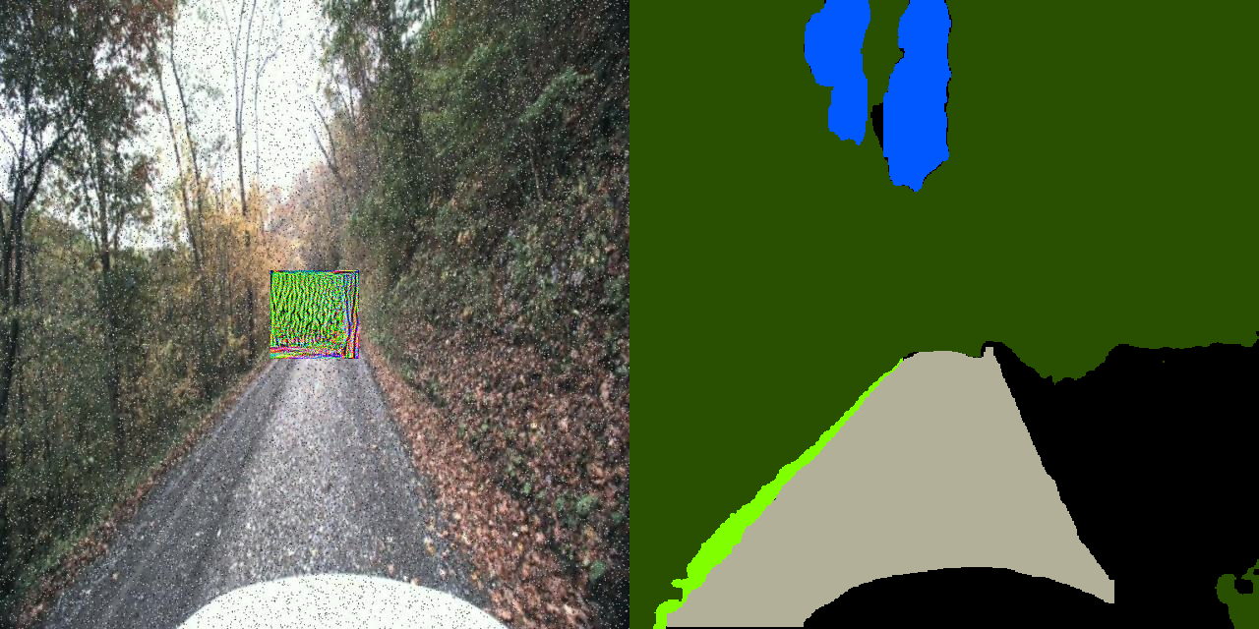
How Adversarial Patches Impact Traversable Terrain Identification
Clean Image Patched Image
Clean image correctly segments traversable areas (Green)
Patched image misclassifies grass as unlabeled (Black)
Patch disrupts terrain understanding outside the patch region

Slide 11
Overall Impact on Traversable Class Prediction Accuracy
Drops in overall segmentation accuracy have direct impacts on the segmentation model’s ability to discern traversable terrain from non-traversable terrain.
Traversable Class Prediction Accuracy Drop Per Model (Outside Patch Region)
Class ID | YOLOv11n-seg |  | YOLOv11s-seg |  | YOLOv12n-seg |  | YOLOv12s-seg |  | ResNet34+UNet |  | EfficientViT
Evaluation Type | Clean | LaVAN | Clean | SemSeg | Clean | LaVAN | Clean | SemSeg | Clean | AdvTransfer | Clean | PatchWise
Traversable Grass | 83.88% | 57.02% | 79.28% | 58.87% | 94.85% | 70.35% | 88.84% | 55.68% | 71.80% | 81.59% | 95.75% | 89.50%
Smooth Trail | 97.15% | 52.37% | 96.05% | 52.38% | 98.29% | 89.01% | 97.72% | 59.19% | 94.73% | 88.86% | 99.13% | 95.41%
Avg Drop |  | 35.82% |  | 32.04% |  | 16.89% |  | 35.85% |  | -1.96% |  | 4.99%

Slide 12
Off-Road vs. On-Road Comparison
We match prior study patch sizes (2.15%, 3.81%, and 8.58% of the total image area)
We report mIoU and mAcc on out-of-patch pixels.
This isolates the patch-induced misclassification from the physical occlusion effects
Performance drops increase with patch size.
Off-road results follow the same trend as on-road.
 | Small (2.15%) |  |  |  | Medium (3.81%) |  |  |  | Large (8.58%)
 | Clean |  | Patched |  | Clean |  | Patched |  | Clean |  | Patched
Model | mIoU | mAcc | mIoU | mAcc | mIoU | mAcc | mIoU | mAcc | mIoU | mAcc | mIoU | mAcc
YOLOv11n | 0.731 | 0.808 | 0.446 | 0.633 | 0.731 | 0.808 | 0.361 | 0.552 | 0.731 | 0.809 | 0.336 | 0.527
YOLOv11s | 0.576 | 0.665 | 0.479 | 0.597 | 0.576 | 0.665 | 0.426 | 0.556 | 0.577 | 0.665 | 0.338 | 0.495
YOLOv12n | 0.826 | 0.877 | 0.612 | 0.766 | 0.826 | 0.877 | 0.435 | 0.620 | 0.826 | 0.877 | 0.352 | 0.537
YOLOv12s | 0.740 | 0.795 | 0.617 | 0.710 | 0.740 | 0.795 | 0.544 | 0.646 | 0.740 | 0.795 | 0.484 | 0.607
ResNet34+UNet | 0.564 | 0.663 | 0.462 | 0.619 | 0.564 | 0.663 | 0.514 | 0.641 | 0.565 | 0.663 | 0.527 | 0.638
EfficientViT | 0.889 | 0.922 | 0.798 | 0.865 | 0.889 | 0.923 | 0.761 | 0.835 | 0.890 | 0.924 | 0.668 | 0.770

Slide 13
Real-time Inference Speed and Performance
Evaluated at 544x1024 resolution
FP32, averaged over 200 runs using a single NVIDIA V100 GPU
All models achieve real-time inference
Key Results
EfficientViT is fastest at 215 FPS.
YOLOv11 and YOLOv12 remain competitive.
All models run at >80 FPS at this resolution.
Model | Time (ms) | FPS | Params (M) | Mem (MB)
ResNet34+UNet | 12.30 | 81.3 | 24.44 | 329.9
EfficientViT-b0 | 4.65 | 215.3 | 0.71 | 65.0
YOLOv11n-seg | 8.20 | 121.9 | 2.84 | 67.4
YOLOv11s-seg | 9.00 | 111.1 | 10.07 | 135.9
YOLOv12n-seg | 11.96 | 83.6 | 2.81 | 94.4
YOLOv12s-seg | 12.32 | 81.2 | 9.77 | 160.6

Slide 14
Conclusion
EfficientViT is the most robust architecture evaluated,
Highest clean prediction accuracy (96.85%)
Smallest degradation under adversarial patches (5.35% Accuracy Drop)
YOLOv11-seg and YOLOv12-seg are fast enough for real-time off-road navigation, but are less robust under patch attacks:
Inference speed: 111 to 122 FPS for YOLOv11, 81 to 84 FPS for YOLOv12
Larger degradation under patch attacks than EfficientViT (26.55% Accuracy Drop)
Off-road perception remains uniquely vulnerable to adversarial patches:
Traversable terrain (e.g. grass and trails) can be misclassified
Performance degradation increases with patch size
Trends are consistent with prior on-road studies

Slide 15
Next Steps
We aim to:
Extend this work from perception models to Vision-Language-Action (VLA) models.
Evaluate how multimodal reasoning affects attack robustness.
Investigate both digital and physical attacks in off-road environments.
Design defenses for robust off-road VLA systems.

